Slide 1



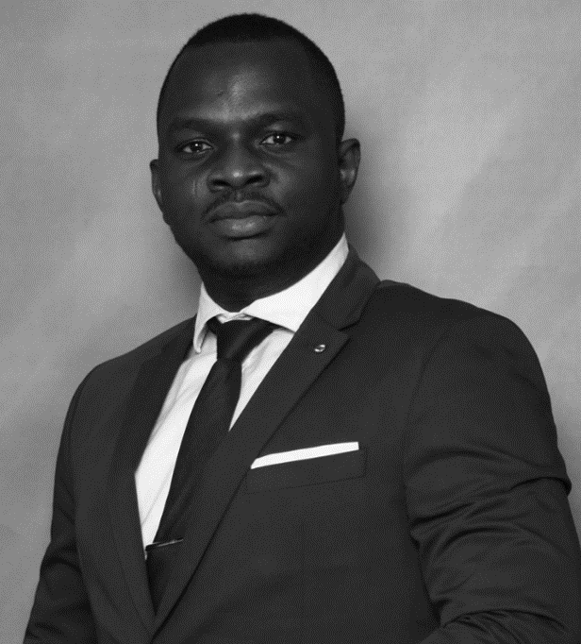

Abdul Salami – Associate
Professional experience
Education and skills
Africa Foresight Group
Developed the 2-year transformation plan to revitalize an unprofitable unit of a West African Holding company
AFG devised a restructuring strategy for four firms into a business group
McKinsey & Company, Lagos Nigeria serving in Nigeria and South Africa
Led and monitored, as part of the Project Management Office, the deployment of Last Planner System® at a coal power plant construction by coaching and mentoring the client; reduced scheduled completion by two years
Supported the development of a top African bank’s 5-year strategy to double its revenue and manage organizational change by developing its customer acquisition strategy for the mass market; acquired 30% target customers in 1 year
Championed product redesign and strategic marketing initiatives for the core product of a major African Telco through benchmarking and focus groups; increased revenues by 10% within 6 months and retained market share
Coached and mentored four client team members on sustainable leadership and strategy implementation for a 90GW power portfolio, a leadership development initiative
Sahara Group, Power division of a Nigerian group of companies
Developed innovative change management and risk management strategies to champion on-site organization redesign and process improvement; doubled plant revenues within 2 years and improved plant reliability by 20%
Abdul holds an MBA from Ivey Business School, Canada and MSc in Energy Systems Engineering from the Cranfield University, UK
He is also a certified project management professional (PMP) with the Project Management Institute (PMI), USA
Abdul speaks English fluently
Introduction
I am a solutions-oriented strategy consultant, that revels in the opportunity to uncover innovative insights to solve business problems. I look forward to co-creating tailored solutions for your organization.
I joined Africa Foresight Group in 2018 as an opportunity to support African business leaders’ growth journeys, and the network of professionals here has proven invaluable to achieving AFG’s vision of elevating African businesses and people.

